Slide 1
IIR Filter

Slide 2
MATLAB also has great resources for IIR filters
https://www.mathworks.com/help/signal/ug/iir-filter-design.html
IIR filter stands for infinite impulse response filter. h[n] of IIR filter has infinite length

Slide 3
Advantages of IIR filters over FIR filters
IIR filters can achieve the same level of performance as FIR filters with less order
How can IIR filter have less order than FIR filter when h[n] is of infinite

Slide 4
Disadvantages of IIR filters over FIR filters
IIR filter have infinite length h[n]. Therefore, designers have to worry if the filter is stable, that is
Causal IIR filters can not have linear phase, but this may not matter in some applications

Slide 5
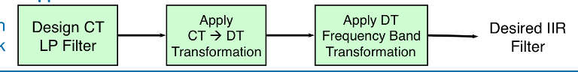
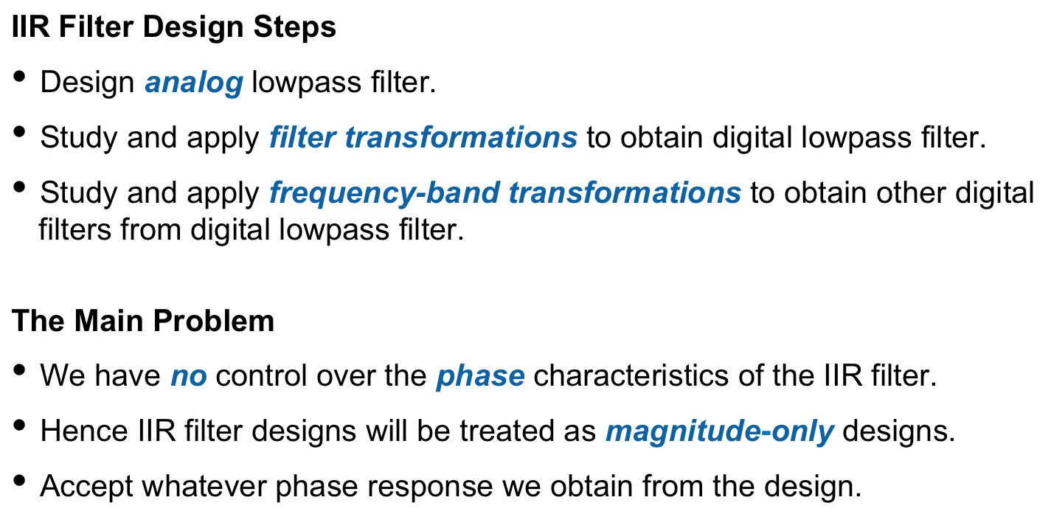
IIR Filter Design Steps

Slide 6
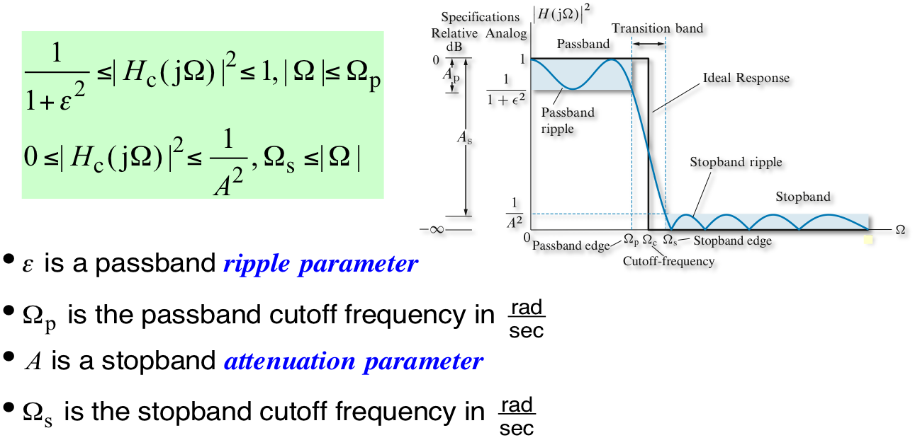
IIR Filter Design Steps
We only design low pass filters. Other type of filters are obtained by frequency shifting after a low pass filter design
Notes:
Compare to FIR filter in Lec 20

Slide 7
Prototype Analog Filters
To design the continuous-time filter, you also need the specifications, passband and stopband frequency and the relative/absolute ripples

Slide 8
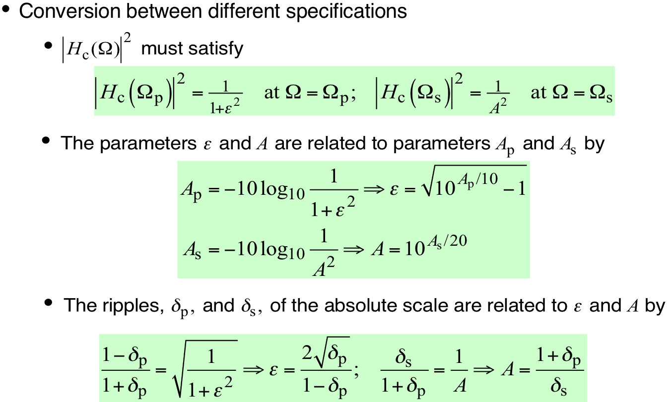
Converting between the specifications

Slide 9
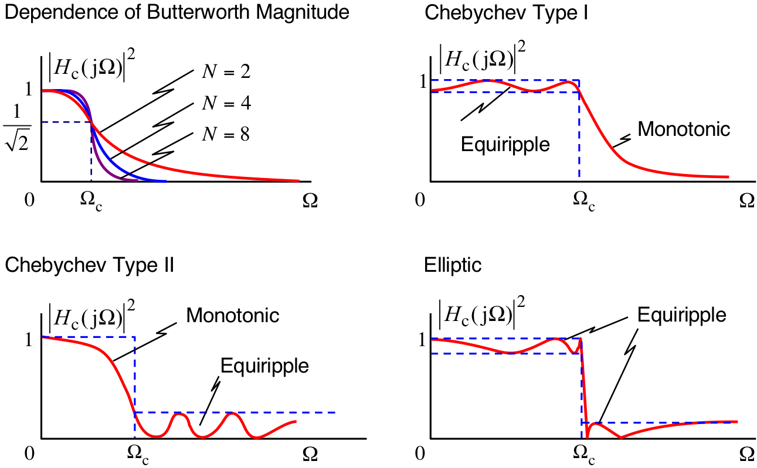
Classical Continuous-Time Filters
There are three approximations that are widely used in practice
Butterworth lowpass
Chebyshev (I and II) lowpass
Elliptic lowpass

Slide 10
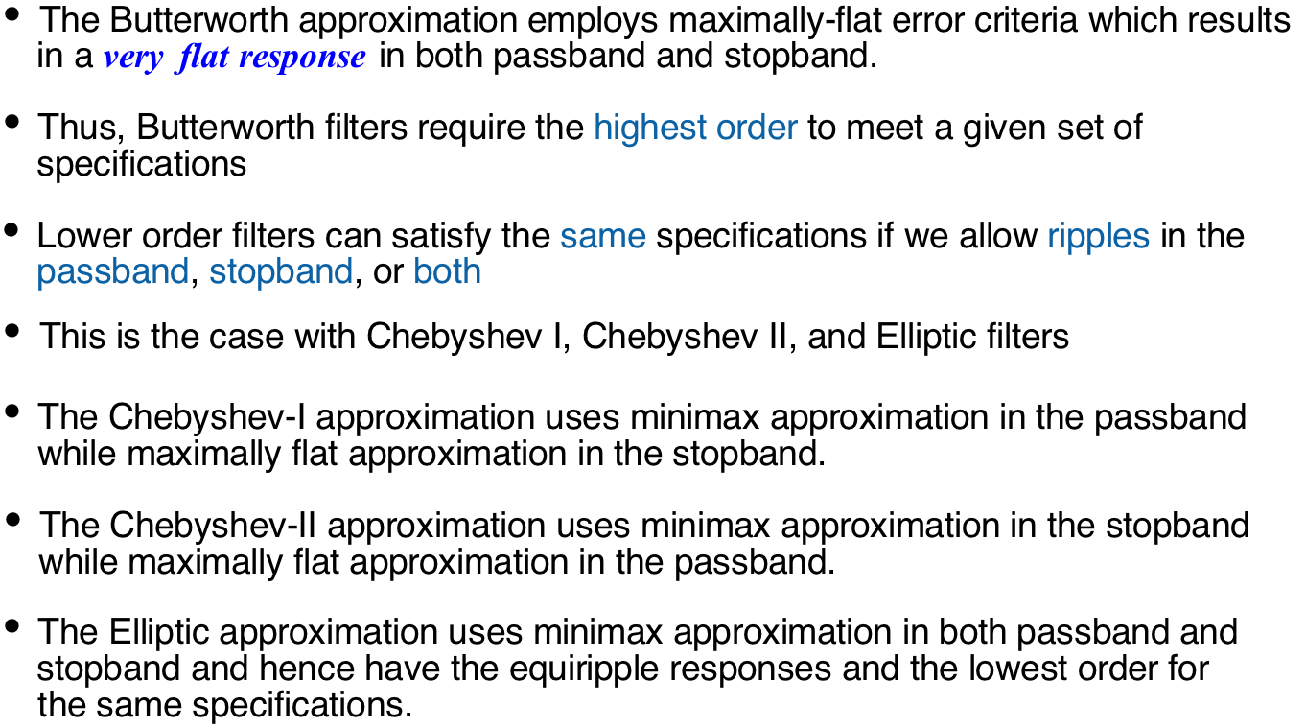
Classical Continuous-Time Filters

Slide 11
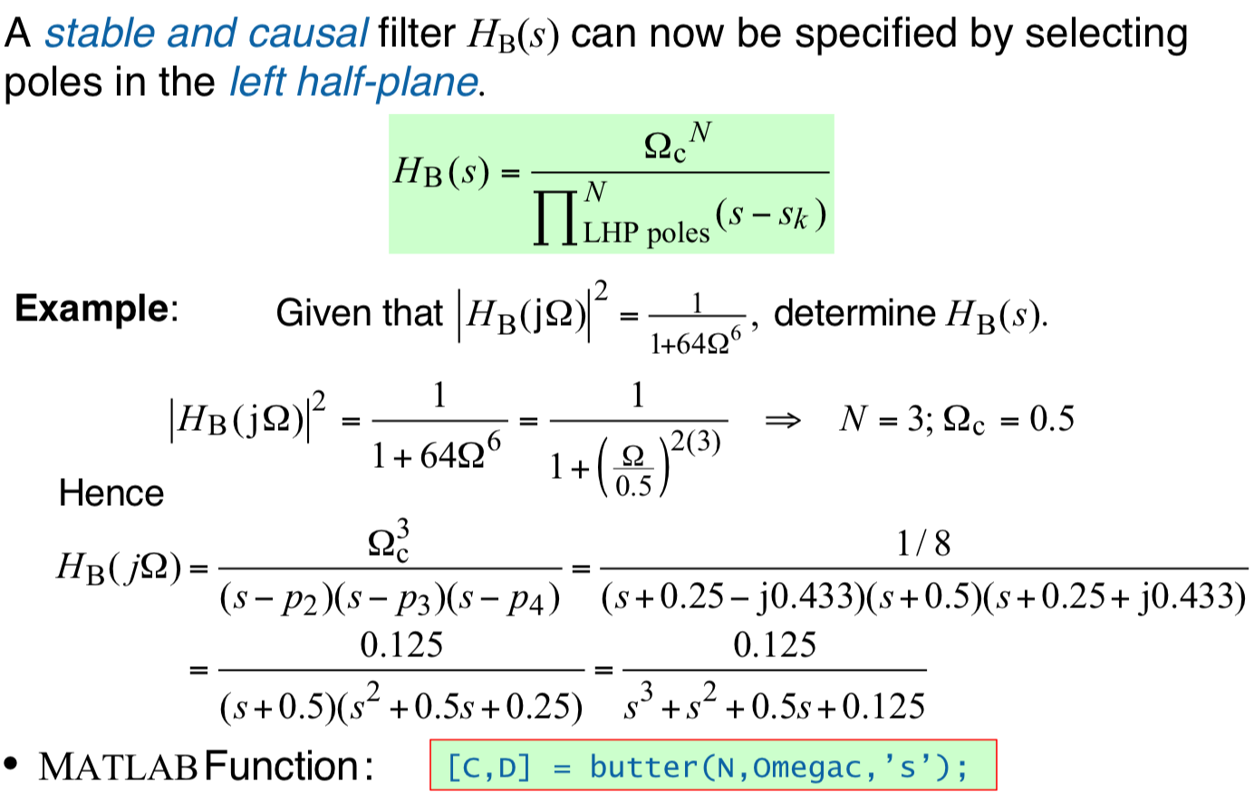
Butterworth Filter
You need the ‘s’ flag. Otherwise, Matlab will design a discrete-time filter

Slide 12
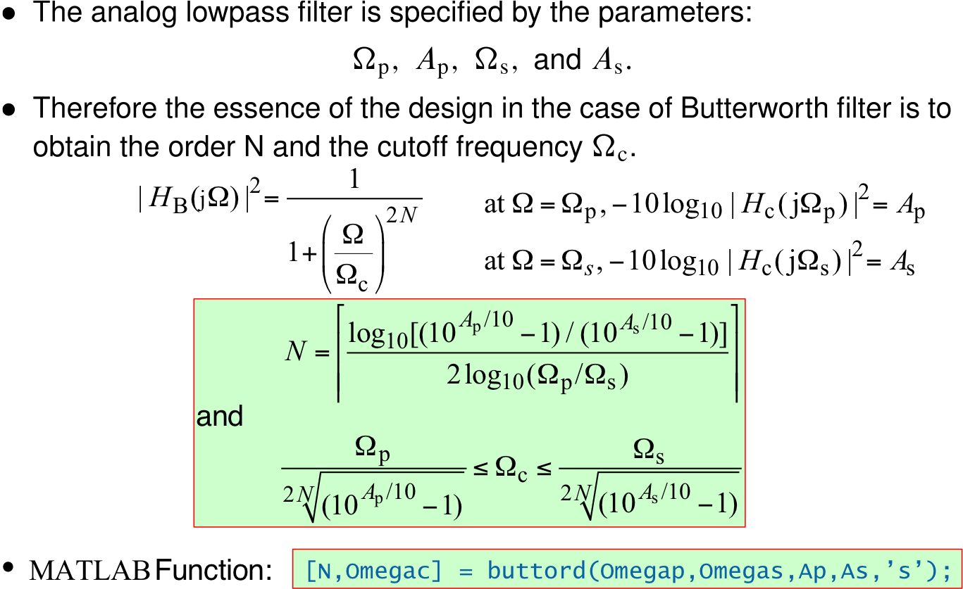
Butterworth filter design: How to determine N and omegac?

Slide 13
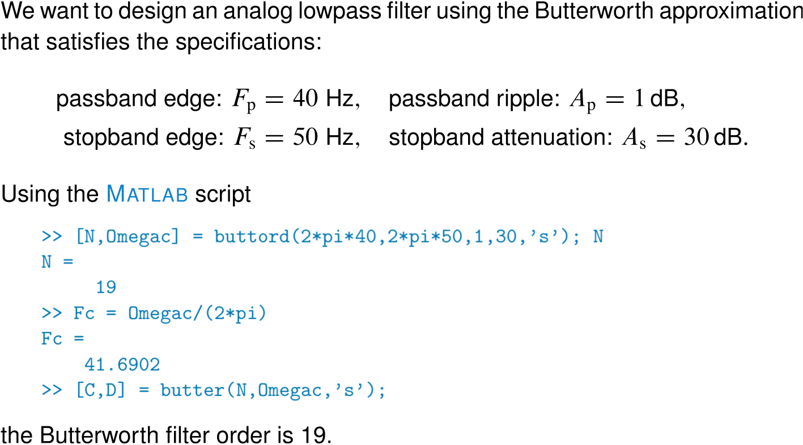
Butterworth continuous-time lowpass filter example

Slide 14
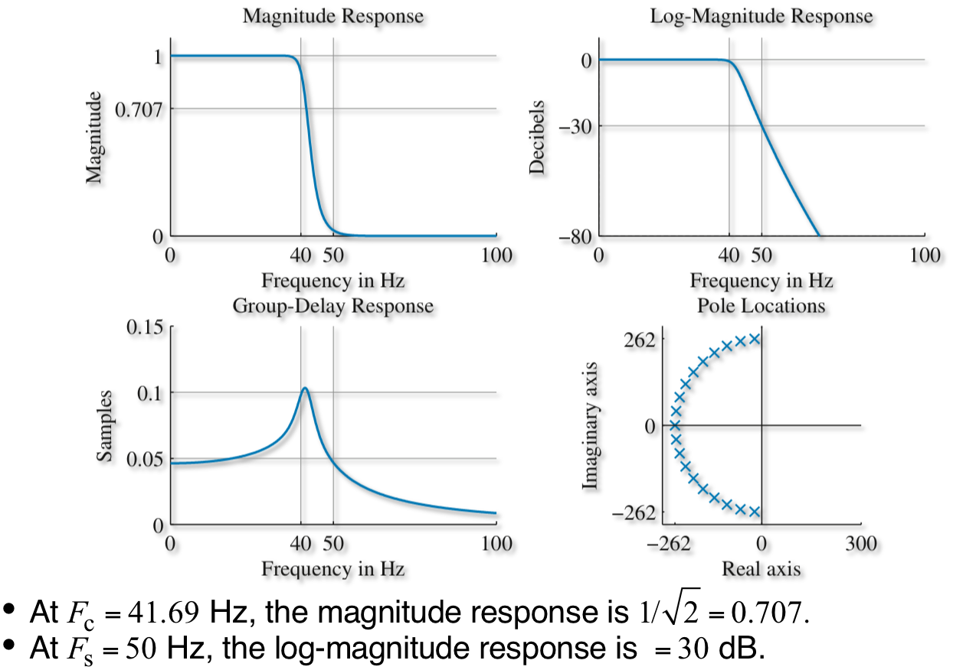
Butterworth continuous-time lowpass filter example
N = 19
Almost linear phase in
passband

Slide 15
Chebyshev Lowpass filter
Chebyshev-I filter have equiripple response in the passband
Chebyshev-II filter have equiripple reponse in the stop band
Chebyshev filters provide lower order than Butterworth filters for the same specification

Slide 16
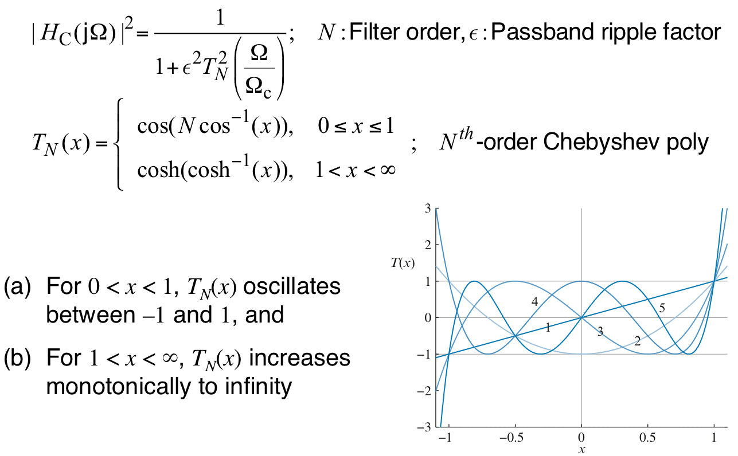
Chebyshev-I Lowpass filter

Slide 17
Chebyshev-I filter design: How to determine N and omegac?

Slide 18
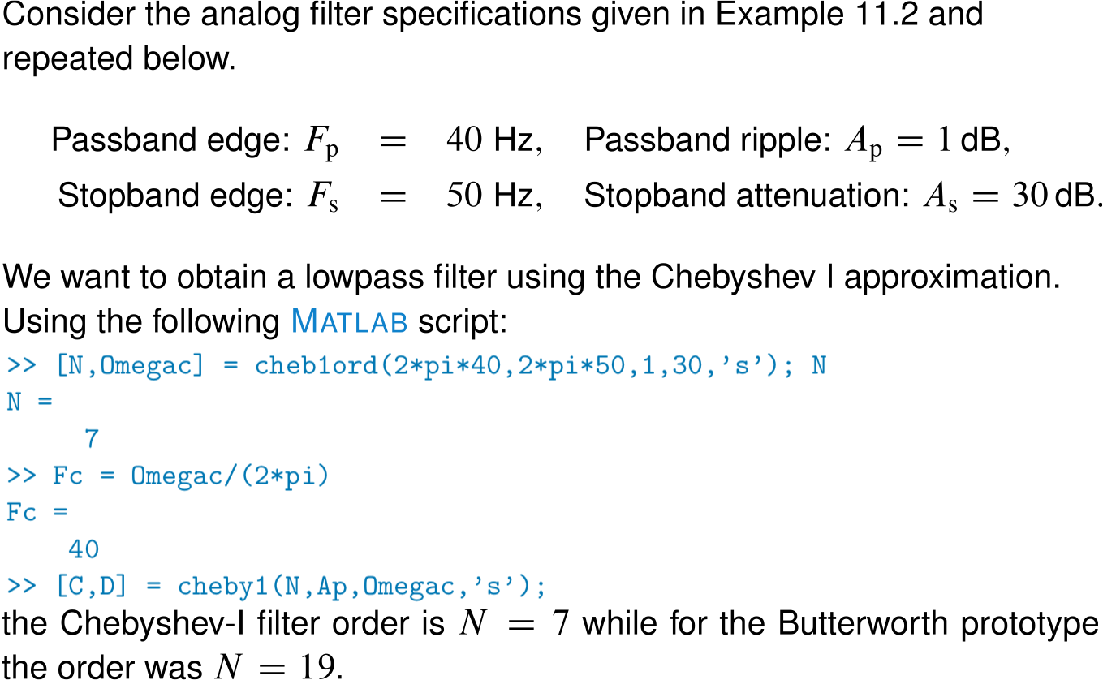
Chebyshev-I continuous-time lowpass filter example

Slide 19
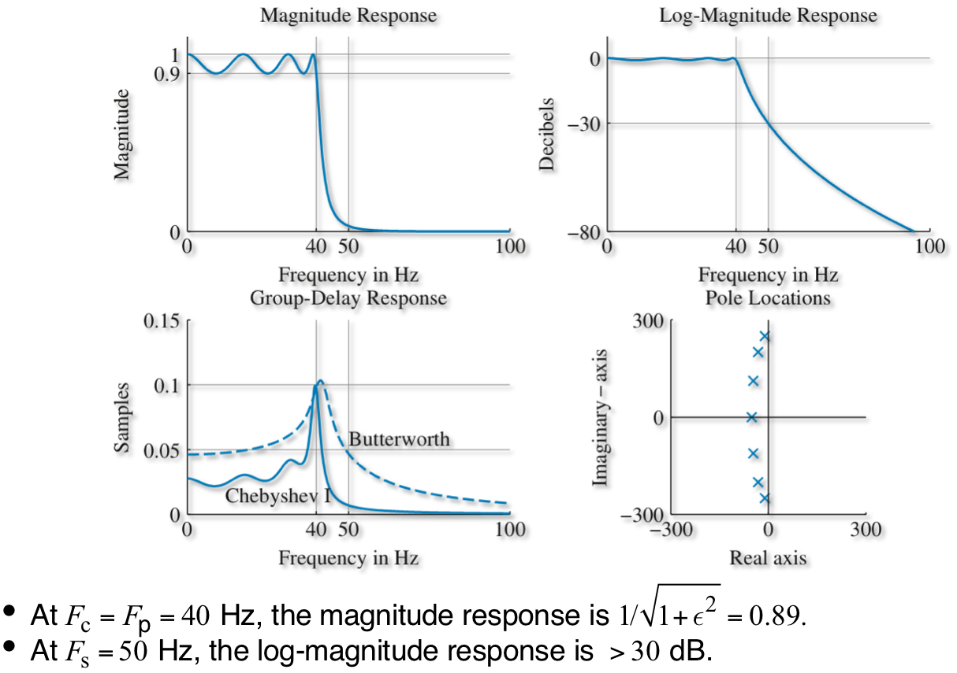
Chebyshev-I continuous-time lowpass filter example
Equiripple in the passband
Definitely not linear phase

Slide 20
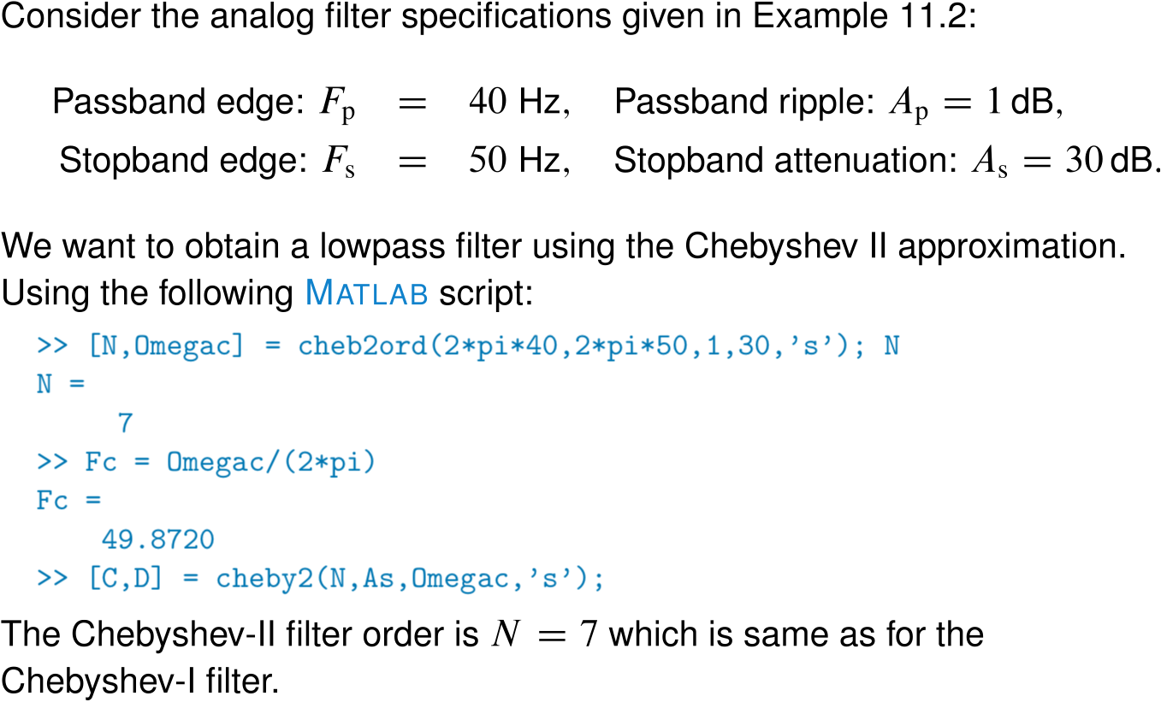
Chebyshev-II continuous-time lowpass filter example

Slide 21
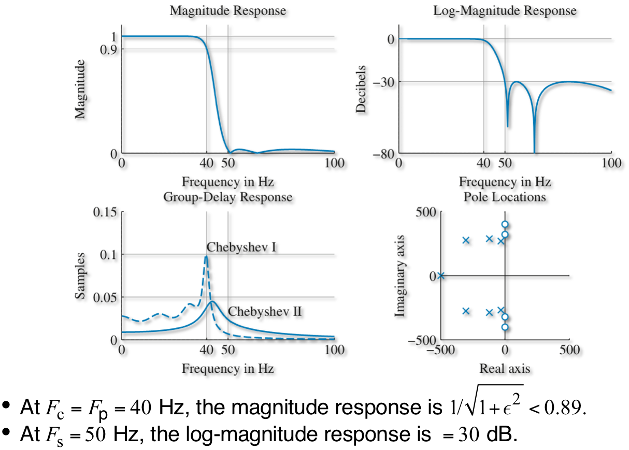
Chebyshev-II continuous-time lowpass filter example
Equiripple in the stopband

Slide 22
Elliptic Lowpass Filters

Slide 23
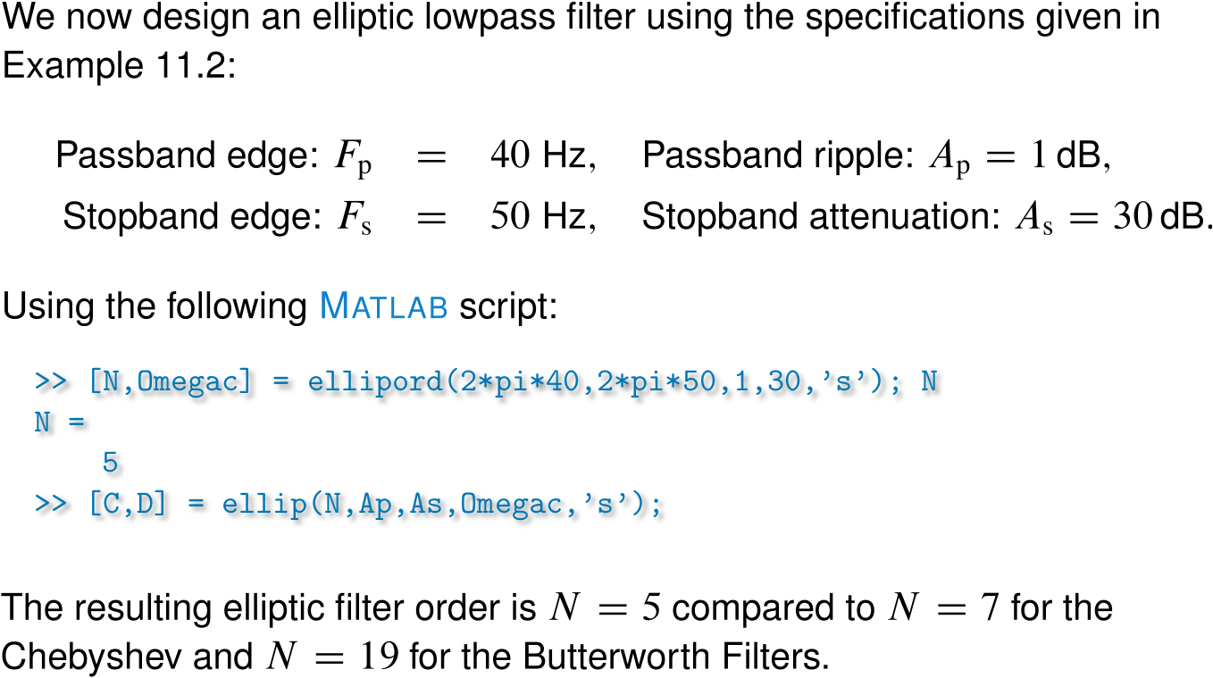
Elliptic continuous-time lowpass filter example

Slide 24
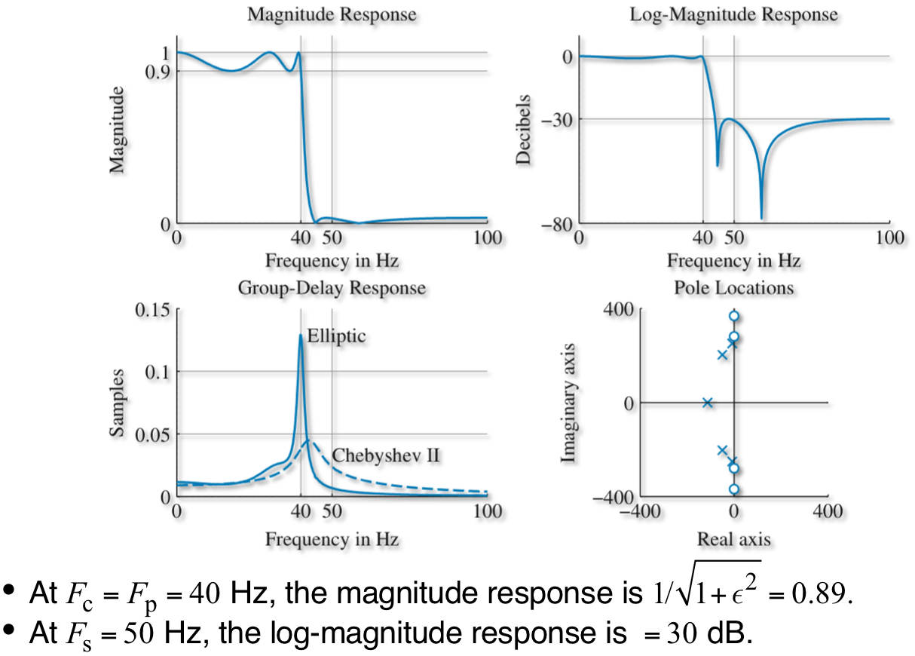
Elliptic continuous-time lowpass filter example

Slide 25
Comparison of prototype filters

Slide 26
Still to do
1) Convert continuous-time filter to discrete-time filters
2) Frequency transform lowpass filter to bandpass, highpass, etc. depending on application

Slide 27
Convert continuous-time filter to discrete-time filters
Many procedures for converting continuous-time filter to discrete-time filter
1) impulse-invariance transformation
2) bilinear transformation (most widely used)

Slide 28
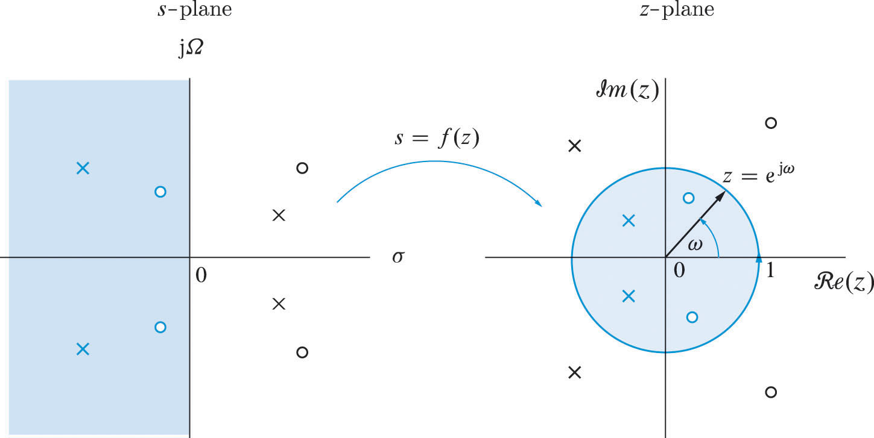
Convert continuous-time filter to discrete-time filters

Slide 29
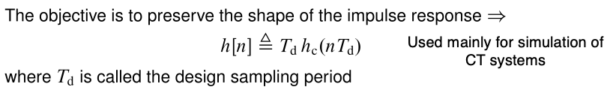
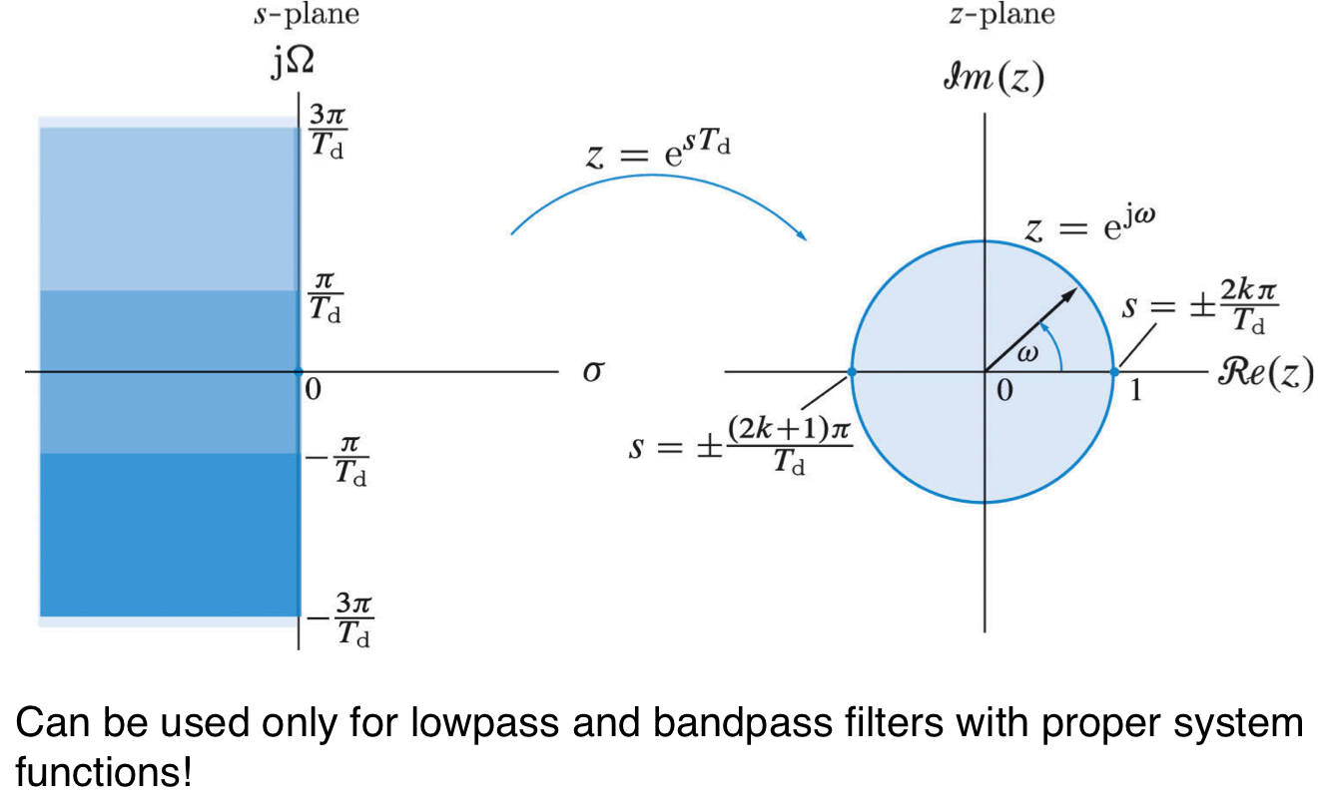
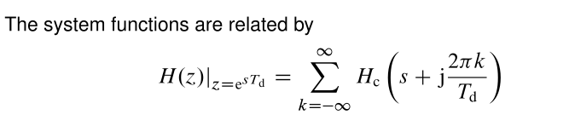
Impulse-Invariance Transformation

Slide 30
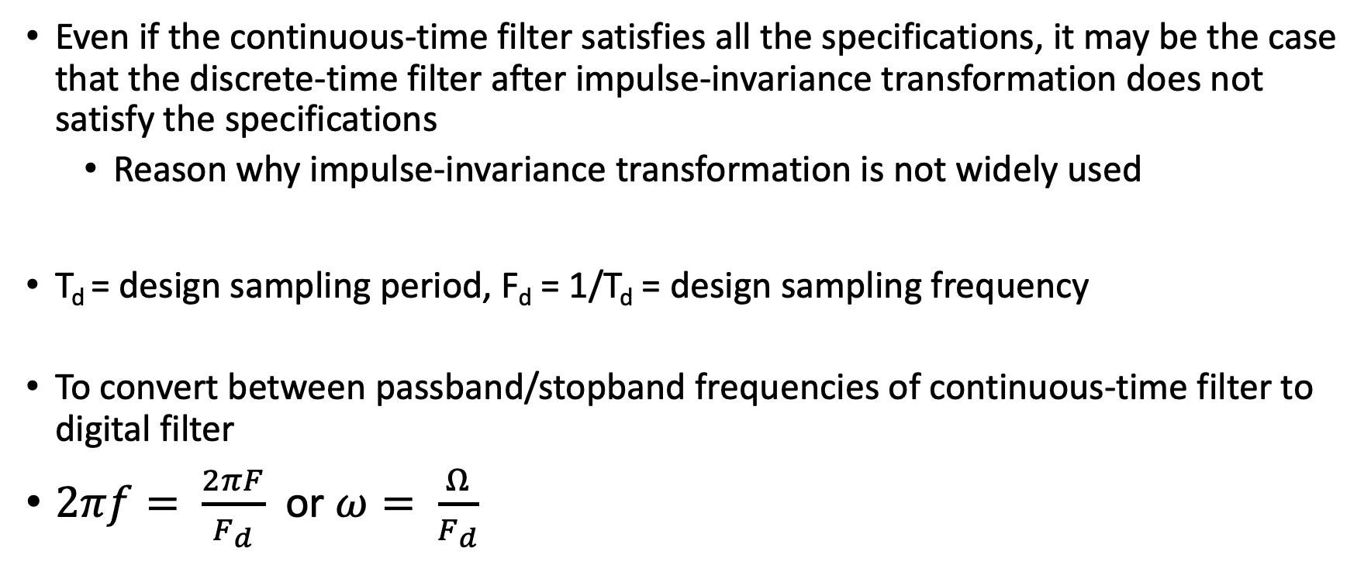
Impulse-Invariance Transformation
Even if the continuous-time filter satisfies all the specifications, it may be the case that the discrete-time filter after impulse-invariance transformation does not satisfy the specifications
Reason why impulse-invariance transformation is not widely used
T_{d} = design sampling period, F_{d} = 1/T_{d} = design sampling frequency
To convert between passband/stopband frequencies of continuous-time filter to digital filter
$2πf= \frac{2πF}{F_{d}}$ or $ω= \frac{Ω}{F_{d}}$

Slide 31
Digital Chebyshev-I using impulse invariance

Slide 32
Digital Chebyshev-I using impulse invariance

Slide 33
Digital Chebyshev-II using impulse invariance

Slide 34
Digital Chebyshev-II using impulse invariance
Does not satisfy design specification!

Slide 35
Bilinear transformation is the better alternative
Bilinear transformation also uses the sampling period T_{d} but it does not affect the transformation. So you can use any value

Slide 36
Bilinear transformation

Slide 37
Digital Chebyshev-II using bilinear transformation

Slide 38
Digital Chebyshev-II using bilinear transformation

Slide 39
Frequency transform lowpass filter to bandpass, highpass, etc. depending on application
Using designed lowpass digital filter we want to design other kinds of filters:
Lowpass
High-pass
Band-pass
Band-stop
This requires a frequency-domain transformation from one z-plane to another z-plane
Design CT
LP Filter
Apply
CT → DT
Transformation
z → z
Frequency Band
Transformation
Desired IIR
Filter

Slide 40
Frequency transform lowpass filter to bandpass, highpass, etc. depending on application
1) Given desired (highpass, bandpass, bandstop) discrete-time filter specifications, we want to convert the frequency specifications to a lowpass filter specification (Design Parameters)
2) Design the discrete-time IIR lowpass filter
3) Map the system function of the lowpass filter to desired filter’s system function (Transformation)

Slide 41
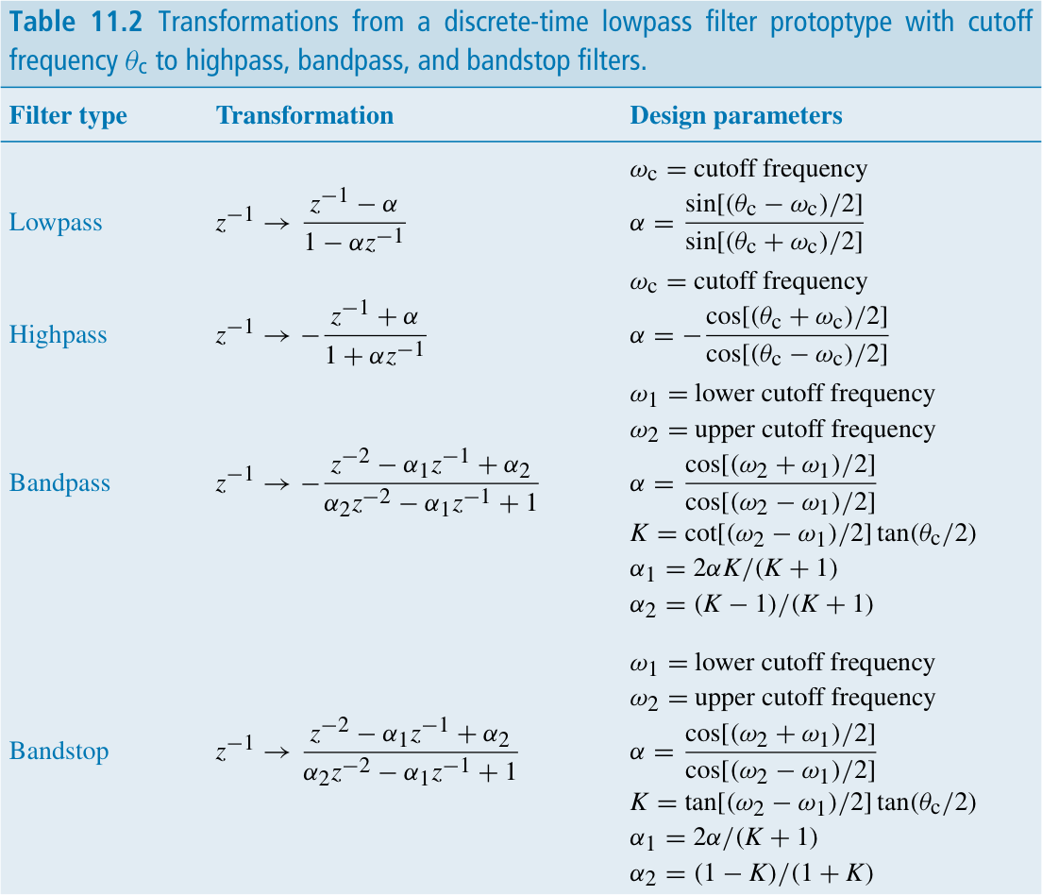

Slide 42
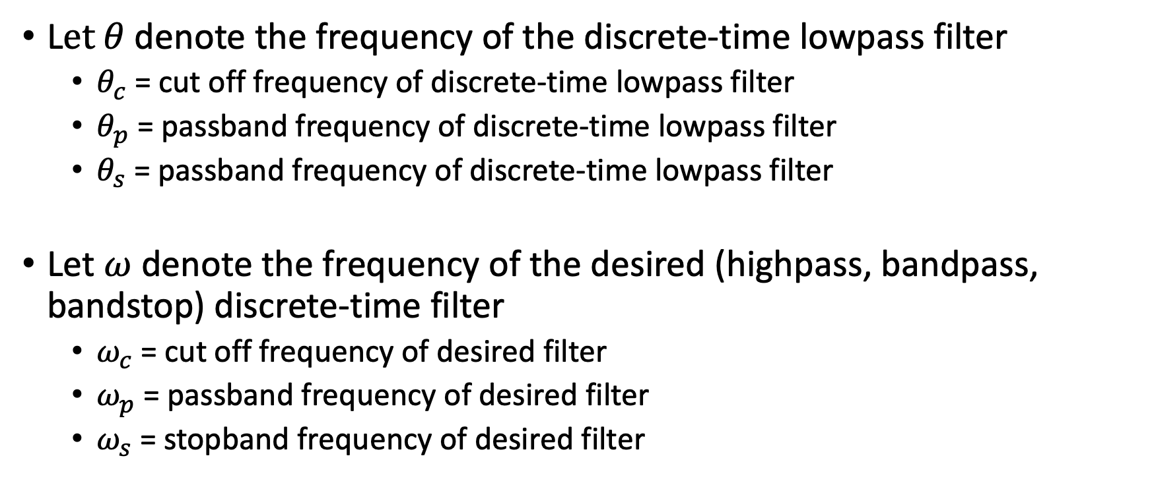
Finding the design parameters
L$et θ$denote the frequency of the discrete-time lowpass filter
$θ_{c}$ = cut off frequency of discrete-time lowpass filter
$θ_{p}$ = passband frequency of discrete-time lowpass filter
$θ_{s}$ = passband frequency of discrete-time lowpass filter
Let $ω$ denote the frequency of the desired (highpass, bandpass, bandstop) discrete-time filter
$ω_{c}$ = cut off frequency of desired filter
$ω_{p}$ = passband frequency of desired filter
$ω_{s}$ = stopband frequency of desired filter

Slide 43
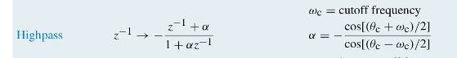
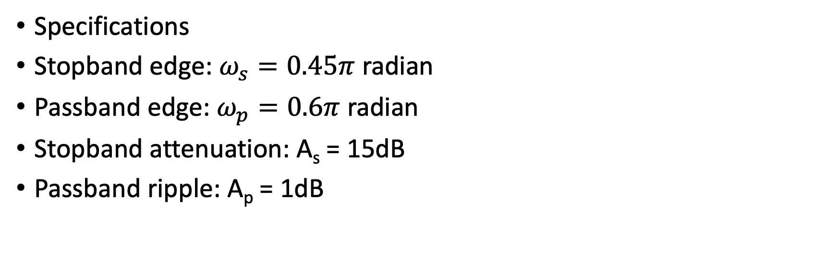
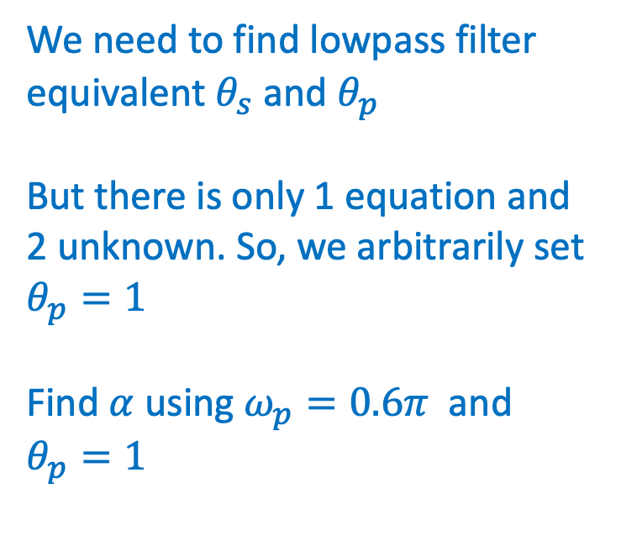
Highpass filter design example
We need to find lowpass filter equivalent $θ_{s}$ and $θ_{p}$
But there is only 1 equation and 2 unknown. So, we arbitrarily set $θ_{p}=1$
Find $α$ using $ω_{p}=0.6π$ and $θ_{p}=1$
Specifications
Stopband edge: $ω_{s}=0.45π$ radian
Passband edge: $ω_{p}=0.6π$ radian
Stopband attenuation: A_{s} = 15dB
Passband ripple: A_{p} = 1dB

Slide 44
Highpass filter design example
Once we have the system function, H(z), of the low pass filter using bilinear transformation
Whenever you see z⁻¹ in H(z), replace with the transformed expression

Slide 45
Filter types

Slide 46
not the same thing!

